Slide 1


Credit card transactions
Project about
- Summary of financial transactions
Financial transactions are essential for informed decision-making, effective budgeting, and performance evaluation. They help individuals and businesses achieve their financial goals and plan for the future.

Slide 2
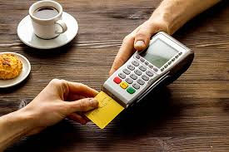
Objectives
- Objectives for Improving Financial Transactions
- Enhancing Transaction Growth :
- Identify opportunities to increase transactions.
_{- Increasing Security :}
- Implement advanced security measures.
_{- Reducing Fraud :}
- Detect unusual transaction patterns early.
- Improving Financial Processes :
- Recommend efficiencies for faster transactions.

Slide 3
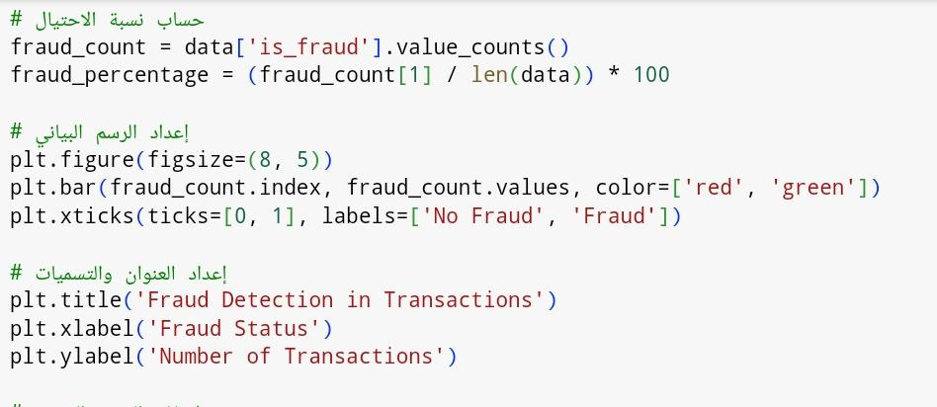
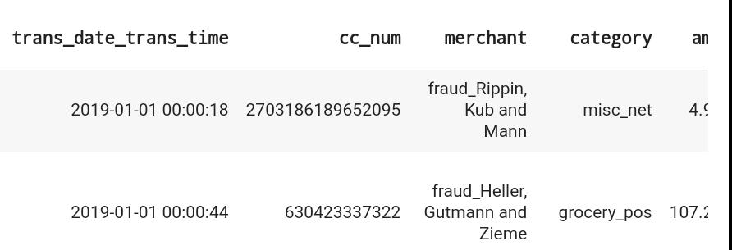
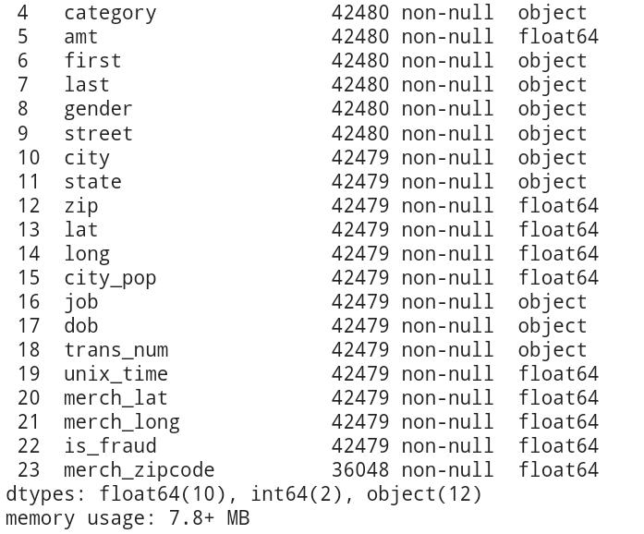
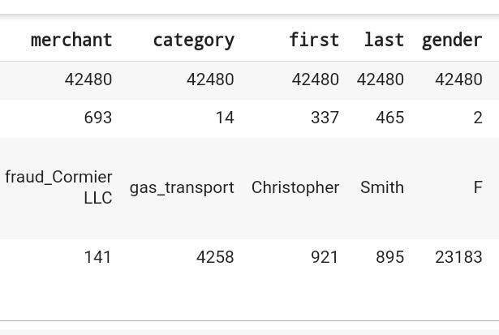
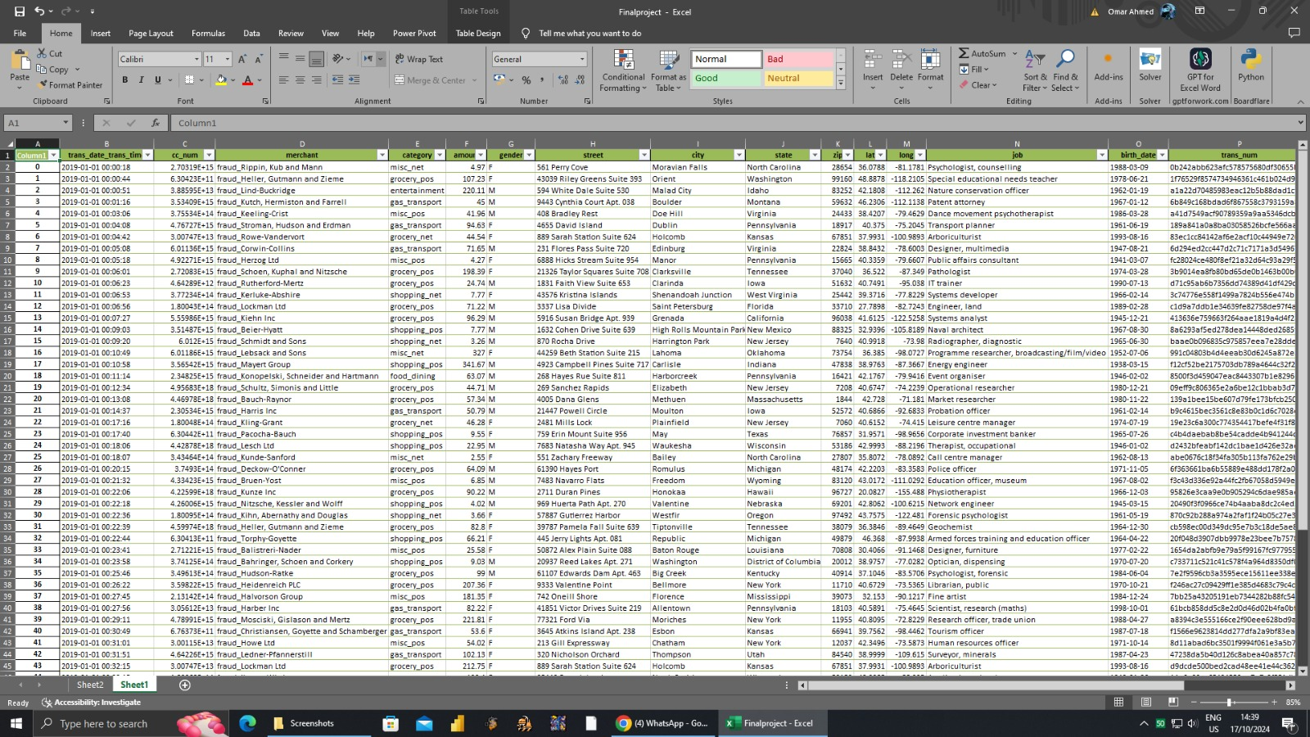
Project steps
Project Steps
Initial Survey: Conduct a survey to gather opinions and insights.
Data Cleaning: Clean the collected data to remove inaccuracies and inconsistencies.
Data Quality Analysis: Analyze the quality of the data to ensure its reliability.
Data Cleaning Process: Perform detailed data cleaning to prepare for analysis.
Data Analysis: Analyze the cleaned data to achieve project objectives.
Results Interpretation: Interpret the findings to draw meaningful conclusion

Slide 4
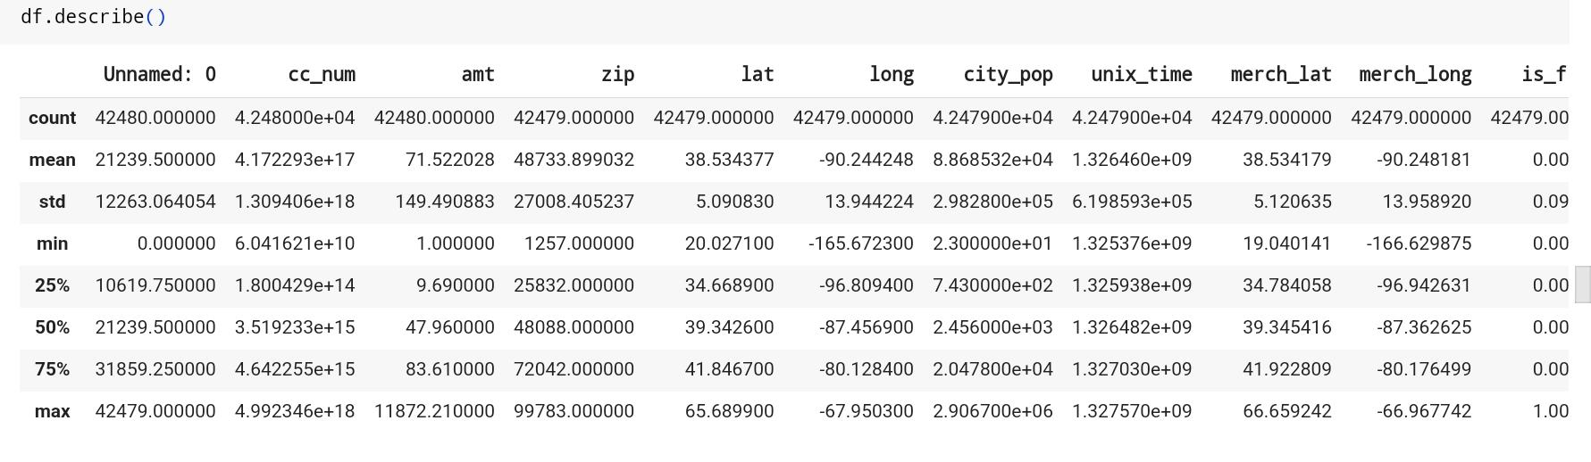
Data cleaning
Steps for Data Cleaning
Data Collection:
Gather data from various sources to ensure a comprehensive dataset.
Remove Duplicates:
Identify and eliminate duplicate entries to maintain data integrity.
Handle Missing Values:
Decide how to address missing values—either by filling them with estimates or removing incomplete records.
Correct Inaccuracies:
Identify and correct any inaccuracies or errors in the data (e.g., typos, incorrect formats).
Standardize Data Formats:
Ensure consistency in data formats (e.g., date formats, currency symbols).
Outlier Detection:
Identify and evaluate outliers that may skew analysis results; decide whether to keep, modify, or remove them.
Data Transformation:
Transform data into the appropriate format or structure needed for analysis.
Validation:
Validate the cleaned data to ensure it meets quality standards and is ready for analysis.

Slide 5
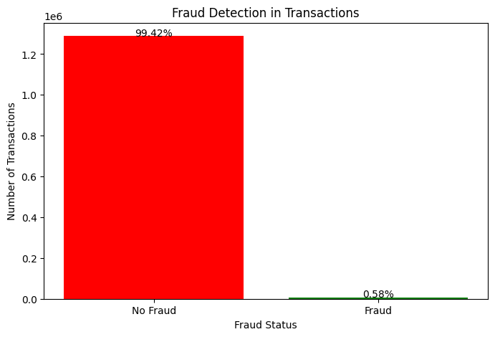
_{First goal analysis} - Enhancing Transaction Growth : - Identify opportunities to increase transactions. _{- Increasing Security :} - Implement advanced security measures.
The number of business transactions versus the number of regular transactions, plus the ratio for each. This analysis helps you understand the extent of cultural diffusion in your data.

Slide 6
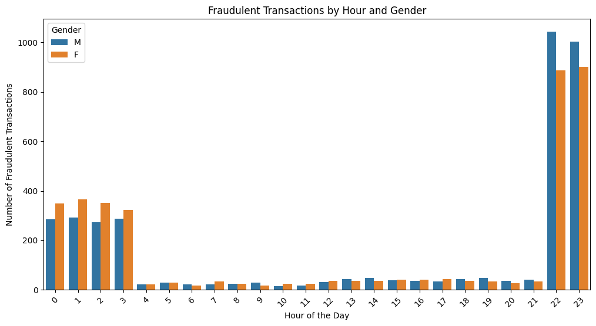
_{First goal analysis} - Enhancing Transaction Growth : - Identify opportunities to increase transactions. _{- Increasing Security :} - Implement advanced security measures.
The graph will show the distribution of fraudulent transactions by hours of the day, distinguishing between genders. You can use this to analyze the most common times of need by gender.

Slide 7
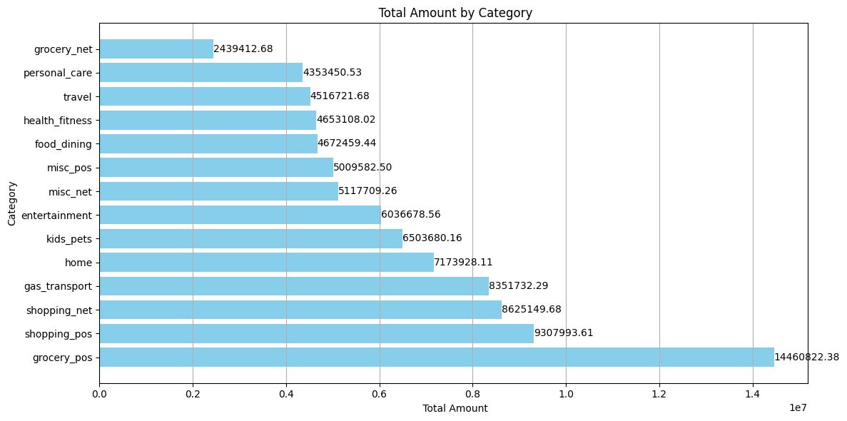
_{Goal number two} - Enhancing Transaction Growth : - Identify opportunities to increase transactions.
shows the distribution of financial amounts according to different categories. This analysis helps you understand how money is spent across different categories.
| Category | Total Amount |
| grocery_pos | 14,460,822.38 |
| shopping_pos | 9,307,993.61 |
| shopping_net | 8,625,149.68 |
| gas_transport | 8,351,732.29 |
| home | 7,173,928.11 |
| kids_pets | 6,503,680.16 |
| entertainment | 6,036,678.56 |
| misc_net | 5,117,709.26 |
| misc_pos | 5,009,582.50 |
| food_dining | 4,672,459.44 |
| health_fitness | 4,653,108.02 |
| travel | 4,516,721.68 |
| personal_care | 4,353,450.53 |
| grocery_net | 2,439,412.68 |

Slide 8
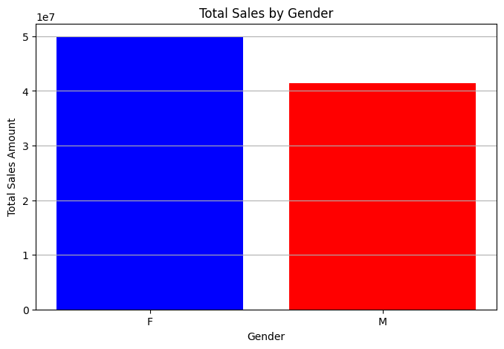
_{Goal number two} - Enhancing Transaction Growth : - Identify opportunities to increase transactions.
Total Sales by Gender

Slide 9
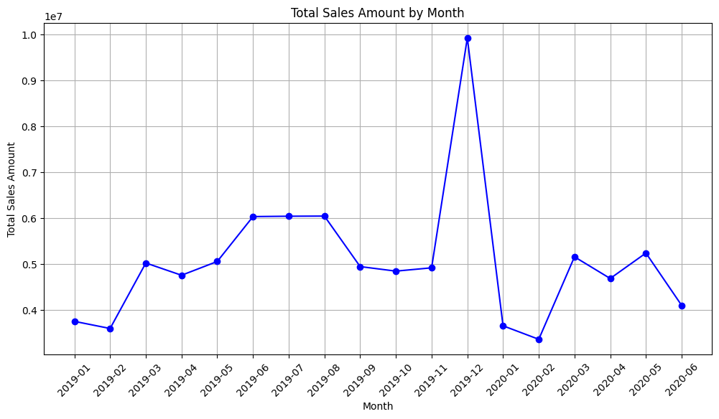
_{Goal number two} - Enhancing Transaction Growth : - Identify opportunities to increase transactions.
Total Sales Amount by Month

Slide 10
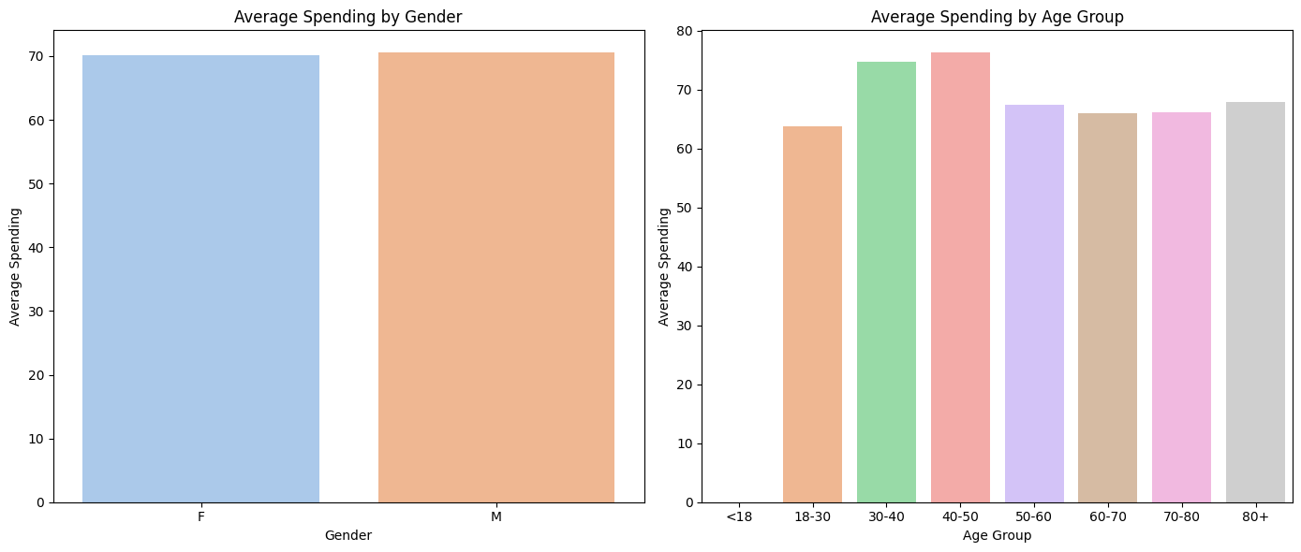
_{Goal number two} - Enhancing Transaction Growth : - Identify opportunities to increase transactions.
Average Spending by Age Group
Average Spending by Age Group

Slide 11
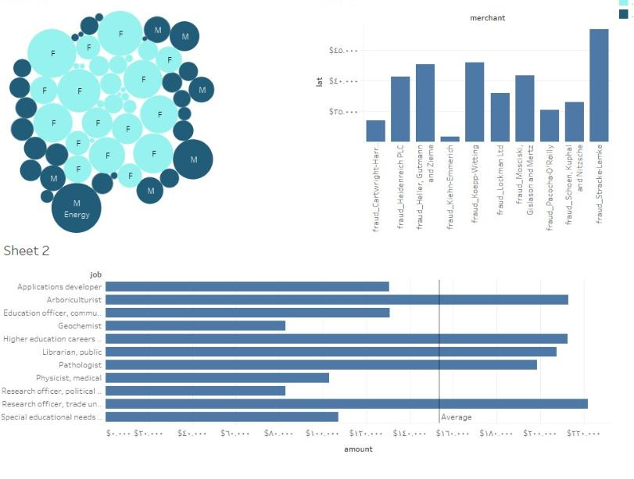
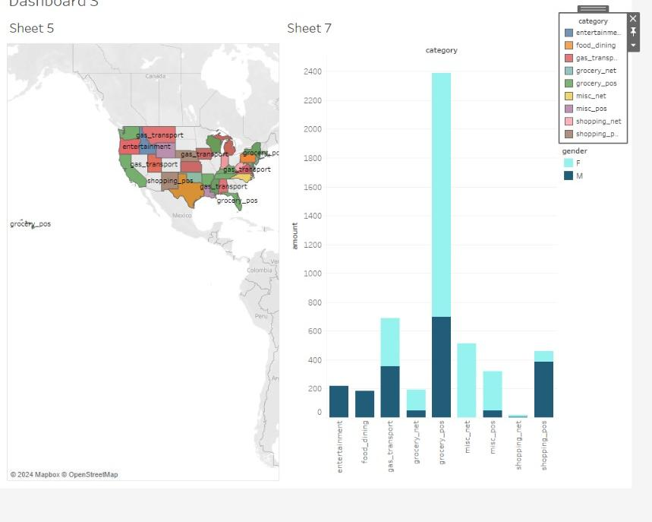
Dash board

Slide 12



Depi Analysts Team
Engy M.Mohammed
Ahmed Abdel naby
Omar Ahmed fawzey

Slide 13
Thank you, Dr. Sarah
Thank you depi egypt

